Slide 1
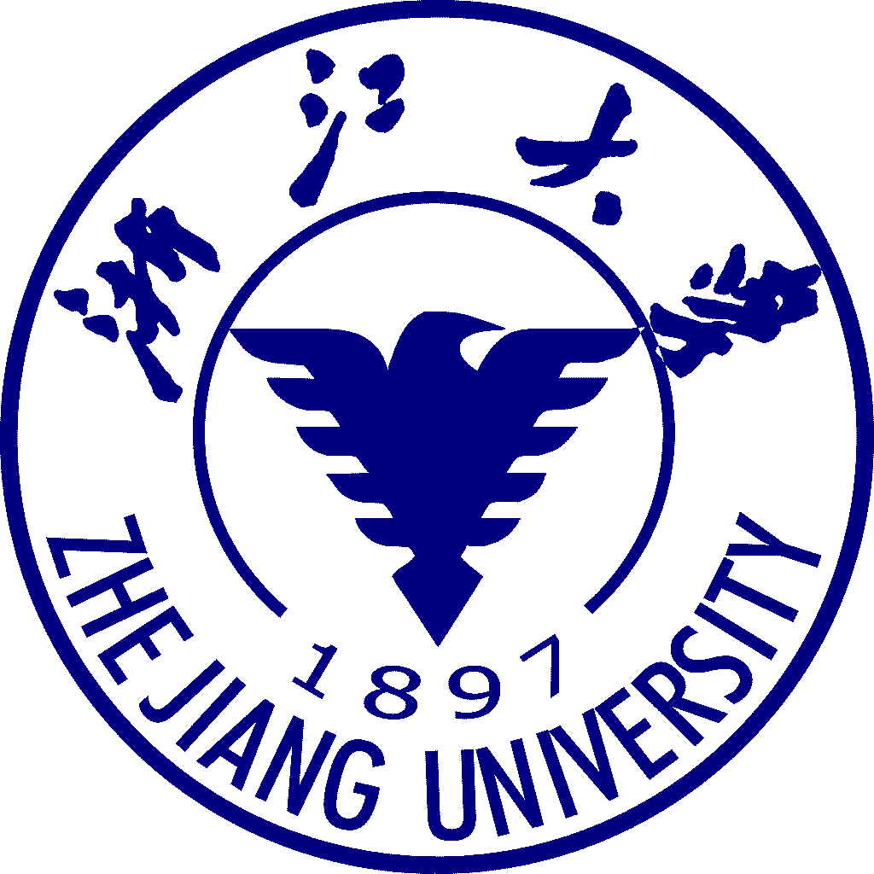
Operating Systems (操作系统 2023秋冬） 曹西-101（周2第9-10节，周4第3-4节） Lab：曹西-503（周4第9-10节） Lecture 1: Overview
Shou Lidan
should @ zju.edu.cn

Slide 2
Outlines of the overview
Previously split in two modules, known as “Principles of Operating System” and “Operating System Practices”
Background
The main purpose of this course
The contents and schedule of the course
The pre-requisite knowledge for the course
Chapter 1 Introduction
Chapter 2 Operating-System Structures

Slide 3
Main objectives An introductory course for Operating System
To learn the basics and internal design of operating systems
To look at both the history and the state-of-the-art techniques used in operating systems
To study the design methodologies applied in OS
To prepare to practice the techniques in your future work
and
To enjoy hacking around!

Slide 4
Main Contents
Overview
Intro
OS structure
Process Management
Processes
Threads
CPU scheduling
Process Synchronization
Deadlocks
Memory Management
Main memory
Virtual memory
Storage Management
File-system interface
File-system implementation
Mass-storage structure
I/O systems

Slide 5
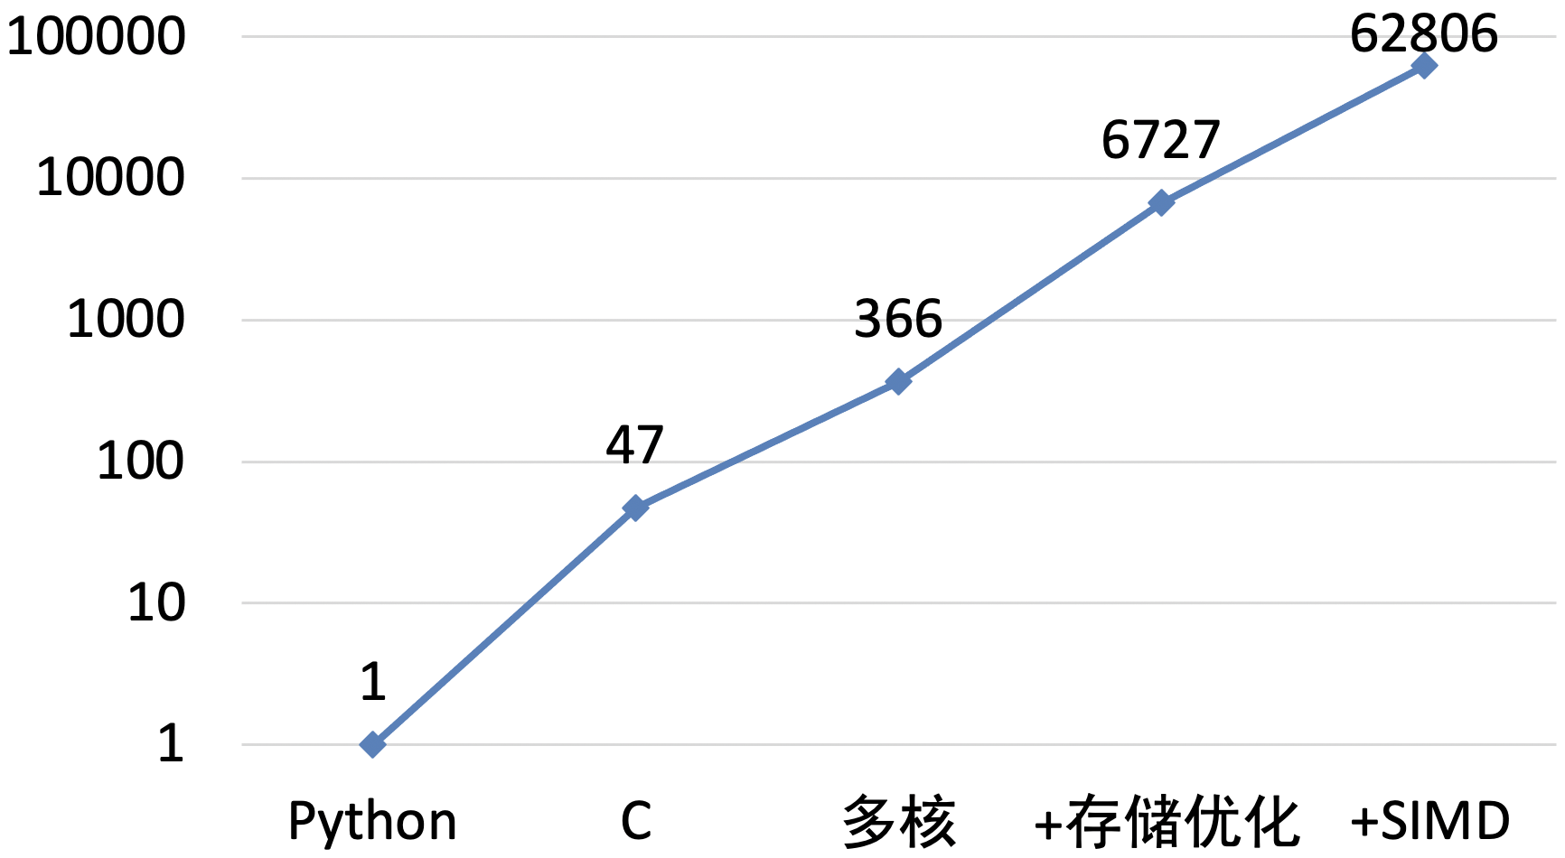
Why is OS still important in ChatGPT-era?
There’s plenty of room at the Top: What will drive computer performance after Moore’s law? https://www.science.org/doi/10.1126/science.aam9744
Performance improved 63000x
C program can be optimized 1300x
multiplying two 4096-by-4096 matrices
for i in xrange(4096):
for j in xrange(4096):
for k in xrange(4096):
C[i][j] += A[i][k] * B[k][j]
Software performance engineering, development of algorithms, and hardware streamlining at the Top can continue to make computer applications faster in the post-Moore era.

Slide 6
Textbook & resources
Main Textbook: Operating System Concepts 7th, Abraham Silberschatz、Peter Galvin，Greg Gagne，2005.1
高等教育出版社（第7版影印版）
10th edition can be found on Amazon.
Course webpage: http://courses.zju.edu.cn/
Lecture slides: http://courses.zju.edu.cn/

Slide 7
Reference Books
边干边学Linux内核指导
xv6: a simple, Unix-like teaching operating system, Russ Cox, Frans Kaashoek, Robert Morris, August 31, 2020
Latest version: https://pdos.csail.mit.edu/6.1810/2022/xv6.html

Slide 8
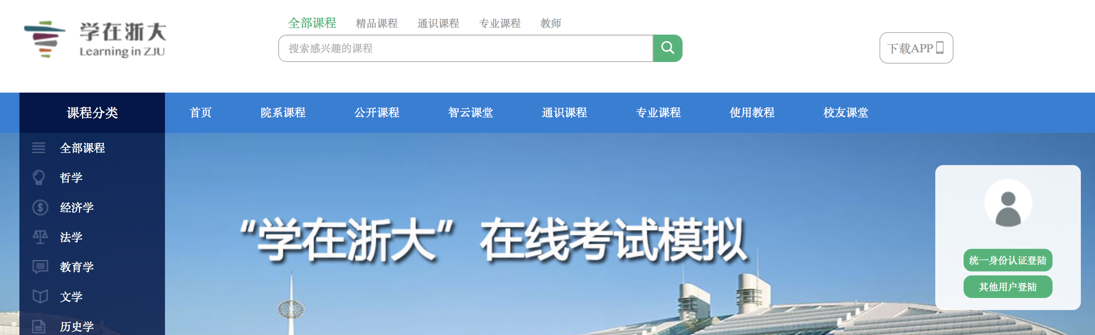
Online Assignments
http://courses.zju.edu.cn/
Teaching Assistants: 李昔霖、李政、刘得志
Please submit your assignment IN TIME!

Slide 9
Pre-requisite Knowledge
Computer system architecture/organization
Programming language C
Data structures

Slide 10
Lab Projects
每个同学独立完成
实验0 RISC-V 64 内核调试 5%
实验1 内核引导；时钟和中断 15%
分组完成5个实验，每组2人
实验2 线程调度,上下文切换 15%
实验3 虚拟内存管理 15%
实验4 用户模式（shell） 20%
实验5 Page fault 20%
实验6 Fork 10%
实验7 File System Bonus 10%

Slide 11
Lab Projects
实验0、1：每个同学提交一份实验报告；
实验2-6：每个同学提交一份实验报告（侧重自己完成的那部分内容）；
自己写的代码必须有详细的注释，每5行代码有注释
每个实验必须写“讨论心得” (实验过程中遇到的问题及解决方法)这部分内容占本实验报告20%分数
每个实验完成后，以个人（lab0-1）/小组（lab2-3-4-5-6）为单位向老师/助教演示，以完成验收。
实验说明文档在 https://zju-sec.github.io/os23fall-stu/
实验所需代码 https://github.com/ZJU-SEC/os23fall-stu

Slide 12
Final Grade
Final exam (50%)
Assignments/homework (5%)
In-class Quiz (5%)
Lab Reports 实验报告 (20%)
Lab Demos 实验验收 (20%)

Slide 13
My suggestions on learning OS
Do a lot of readings before or after the lecture sessions, especially from the English textbook.
Do NOT refer to the so-called “standard” answers to the exercises, they contain mistakes. Once you are caught using the wrong “standard” answers, penalty might be applicable.
Hopefully more interactions during the lectures.

Slide 14
怎样学好系统课程
系统、全局的观察角度 vs 微观、细致的想象能力
王阳明《蔽月山房》
山近月远觉月小，便道此山大于月。
若有人眼大如天，当见山高月更阔。
理论钻研 vs 动手实践
丁肇中：在环境激变的今天，我们应该重新体会到几千年前经书里说的格物致知真正的意义。这意义有两个方面：第一，寻求真理的唯一途径是对事物客观的探索，而不是仅从内心就能领悟；第二，探索的过程不是消极的袖手旁观，而是深度思考勇于探索。
希望我们这一代对于格物和致知有新的认识和思考，使得实干精神真正地变成中国文化的一部分。
寻找模式
螺旋式上升；上下文；封装；抽象；过程式和声明式
寻找兴奋点

Slide 15
Lab0: GDB + QEMU 调试 LINUX
请先将os23fall-stu目录 clone下来
实验说明文档在 os23fall-stu/docs/lab0.md
https://zju-sec.github.io/os23fall-stu/ 可浏览器阅读文档
实验重点：掌握实验环境、尝试简单调试
gdb有一个text UI可以尝试使用，按 Ctrl-x Ctrl-a 进入

Slide 16
Chapter 1 Introduction

Slide 17
Outlines for Chapter ONE
What Operating Systems Do
Computer-System Organization
Computer-System Architecture
Operating-System Structure
Operating-System Operations
Process Management
Memory Management
Storage Management
Protection and Security
Distributed Systems
Special-Purpose Systems
Computing Environments
Overview
Structure
Main parts

Slide 18
Objectives
To provide a grand tour of the major operating systems components
To provide coverage of basic computer system organization

Slide 19
What is an Operating System?
A program that acts as an intermediary between a user of a computer and the computer hardware.
Operating system goals:
Execute user programs and make solving user problems easier.
Make the computer system convenient to use.
Use the computer hardware in an efficient manner.

Slide 20
Computer System Structure
Computer system can be divided into four components
Hardware – provides basic computing resources
CPU, memory, I/O devices
Operating system
Controls and coordinates use of hardware among various applications and users
System & application programs – define the ways in which the system resources are used to solve the computing problems of the users
Word processors, compilers, web browsers, database systems, video games
Users
People, machines, other computers

Slide 21
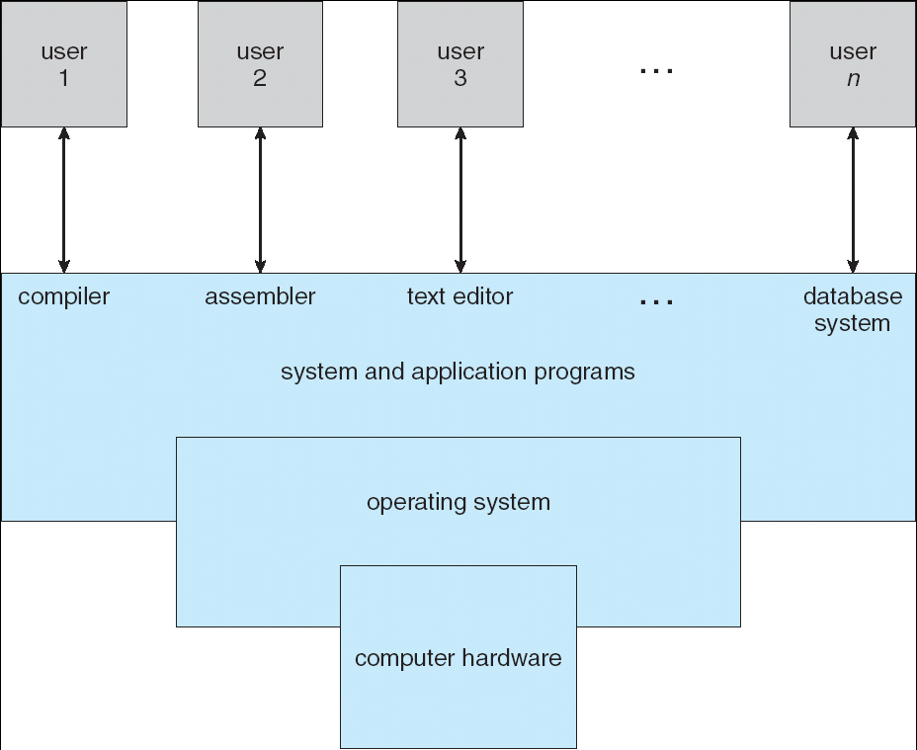
Four Components of a Computer System

Slide 22
Why To Learn Operating Systems?
Building blocks of modern computer software
Applications
Algorithm
Data Structure
System Software

Slide 23

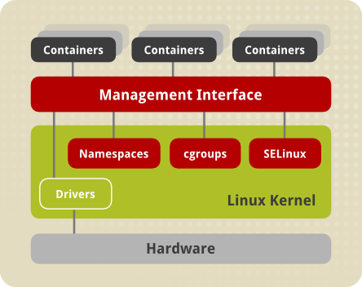
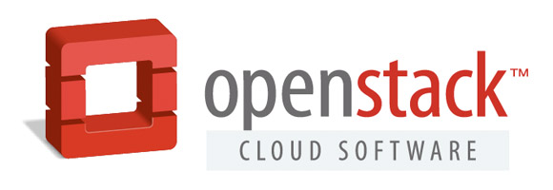


Why To Learn Operating Systems?
New system technologies involving OS:
Cloud Computing becomes the major computing model
Virtualization, Software-Defined Storage/Network
Containers
Hadoop eco-system

Slide 24
Operating System Definition
OS is a resource allocator
Manages all resources
Decides between conflicting requests for efficient and fair resource use
OS is a control program
Controls execution of programs to prevent errors and improper use of the computer

Slide 25
Operating System Definition (Cont.)
No universally accepted definition
“Everything a vendor ships when you order an operating system” is good approximation
But varies wildly
“The one program running at all times on the computer” is the kernel. Everything else is either a system program (ships with the operating system) or an application program

Slide 26

Computer Startup
bootstrap program is loaded at power-up or reboot
Typically stored in ROM or EPROM, generally known as firmware
Initializes all aspects of system
Loads operating system kernel and starts execution

Slide 27
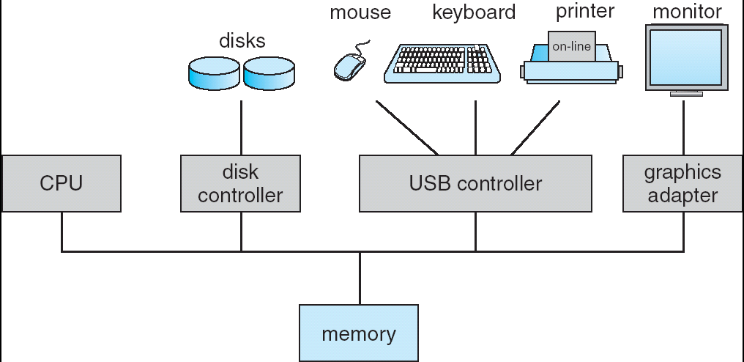
Computer System Organization
Computer-system operation
One or more CPUs, device controllers connect through common bus providing access to shared memory
Concurrent execution of CPUs and devices competing for memory cycles

Slide 28
Computer-System Operation
I/O devices and the CPU can execute concurrently.
Each device controller is in charge of a particular device type.
Each device controller has a local buffer.
CPU moves data from/to main memory to/from local buffers
I/O is from the device to local buffer of controller.
Device controller informs CPU that it has finished its operation by causing an interrupt (via system bus).

Slide 30
Common Functions of Interrupts
Interrupt transfers control to the interrupt service routine generally, through the interrupt vector, which contains the addresses of all the service routines.
Interrupt architecture must save the address of the interrupted instruction.
Incoming interrupts are disabled while another interrupt is being processed to prevent a lost interrupt.
A trap is a software-generated interrupt caused either by an error or a user request (the latter is often referred to as a system call). Note: names may vary across different architectures.
An operating system is interrupt driven.
Note: RISC-V terms
traps
exceptions （错误） & ecalls（系统调用）软中断
Interrupts（硬件中断）
Notes:
注意区分术语上区别

Slide 31
Interrupt Handling
The operating system preserves the state of the CPU by storing registers and the program counter.
Determines which type of interrupt has occurred:
polling by a generic routine
vectored interrupt system
Separate segments of code determine what action should be taken for each type of interrupt

Slide 32
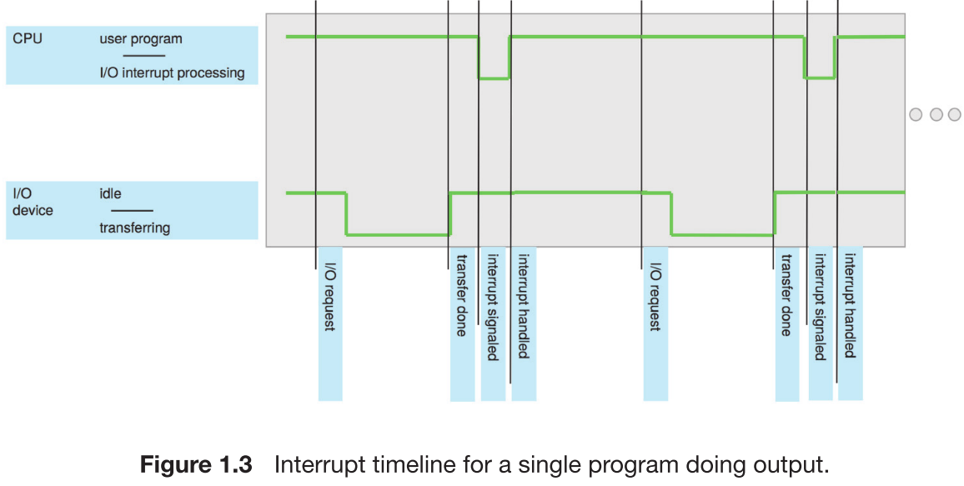
Interrupt Timeline

Slide 33
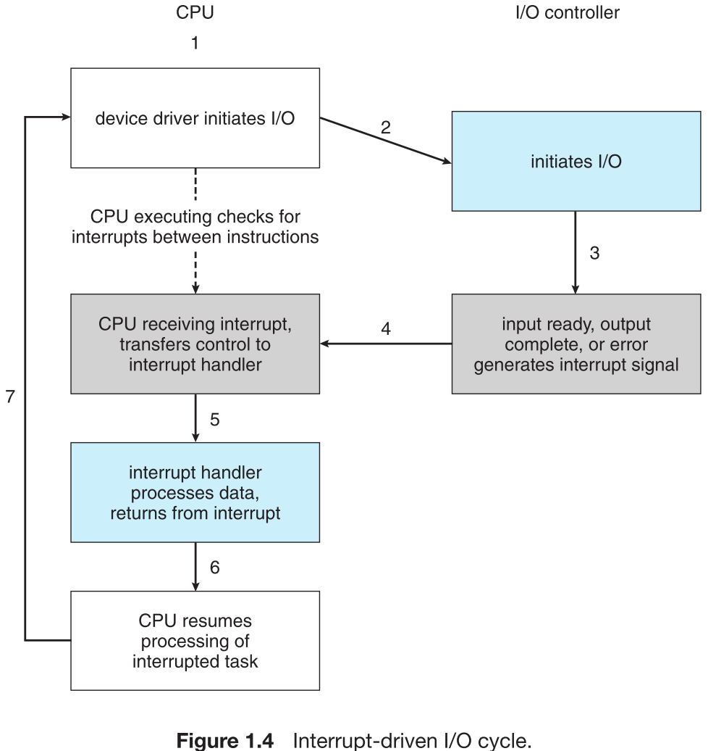
Interrupt-Driven I/O Cycle

Slide 34
I/O Structure – Two I/O Methods
After I/O starts, control returns to user program only upon I/O completion.
Wait instruction idles the CPU until the next interrupt
Wait loop (contention for memory access).
At most one I/O request is outstanding at a time, no simultaneous I/O processing.
After I/O starts, control returns to user program without waiting for I/O completion.
System call – request to the operating system to allow user to wait for I/O completion.
Device-status table contains entry for each I/O device indicating its type, address, and state.
Operating system indexes into I/O device table to determine device status and to modify table entry to include interrupt.
Non-blocking I/O
Notes:
Last sentence: modify table entry to include interrupt.

Slide 35
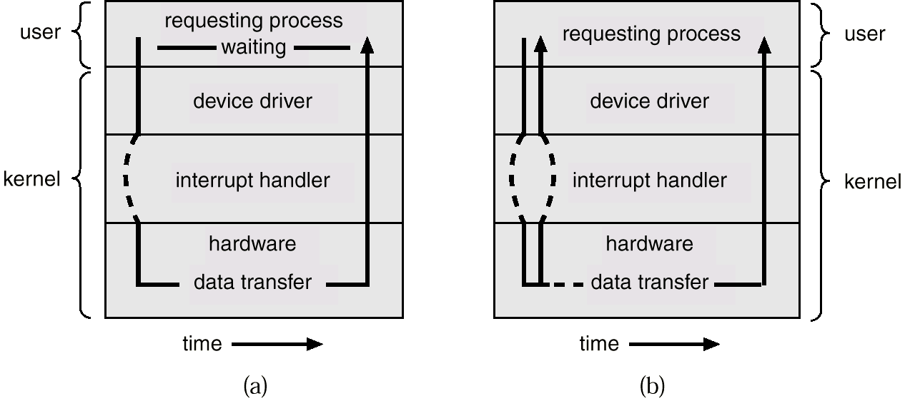
Two I/O Methods
Synchronous同步/阻塞性
Asynchronous异步/非阻塞

Slide 36
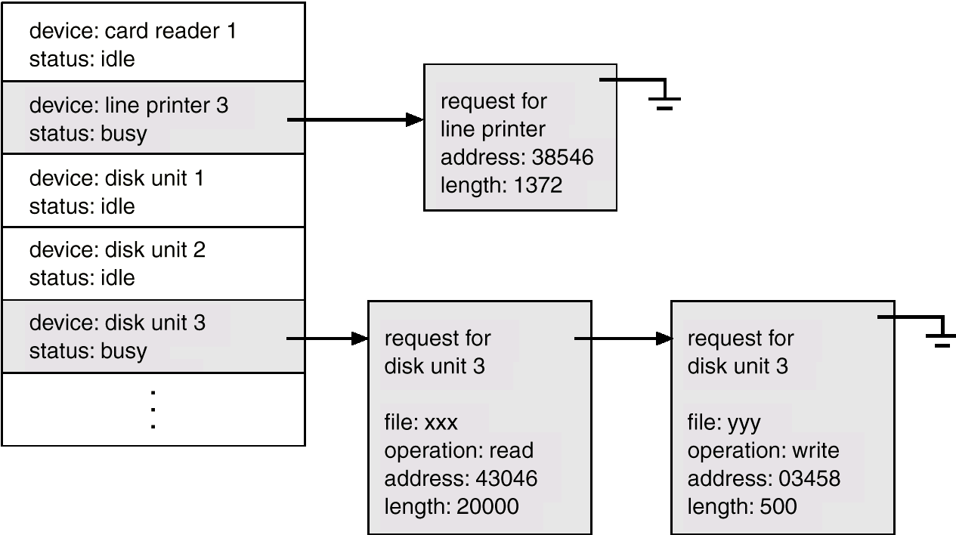
Device-Status Table
新的请求排在最后（一般）

Slide 37
Direct Memory Access Structure
Used for high-speed I/O devices able to transmit information at close to memory speeds.
Device controller transfers blocks of data from buffer storage directly to main memory without CPU intervention.
Only one interrupt is generated per block, rather than the one interrupt per byte.

Slide 38
Storage Structure
Main memory – only large storage media that the CPU can access directly.
Secondary storage – extension of main memory that provides large nonvolatile storage capacity.
Magnetic disks – rigid metal or glass platters covered with magnetic recording material
Disk surface is logically divided into tracks, which are subdivided into sectors.
The disk controller determines the logical interaction between the device and the computer.

Slide 39
Storage Hierarchy
Storage systems organized in hierarchy.
Speed
Cost
Volatility
Caching – copying information into faster storage system; main memory can be viewed as a last cache for secondary storage.

Slide 40
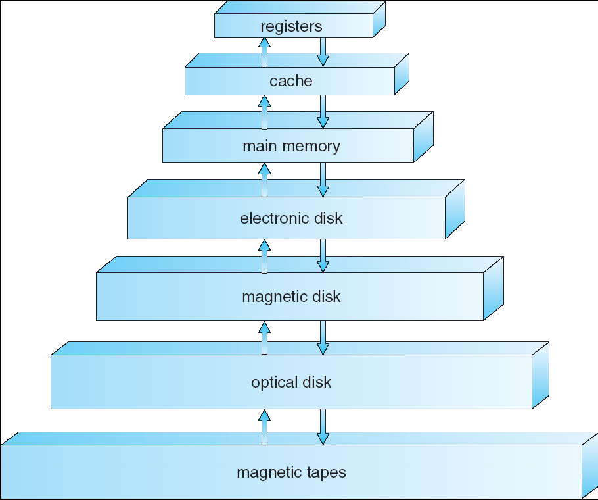



Storage-Device Hierarchy
SSD

Slide 41
Caching
Important principle, performed at many levels in a computer (in hardware, operating system, software)
Information in use copied from slower to faster storage temporarily – Speed mismatch
Faster storage (cache) checked first to determine if information is there
If it is, information used directly from the cache (fast)
If not, data copied to cache and used there
Cache smaller than storage being cached
Cache management important design problem
Cache size and replacement policy

Slide 42
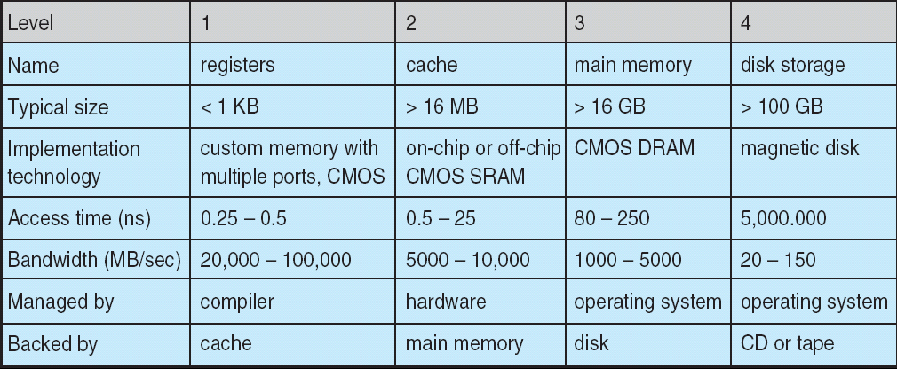
Performance of Various Levels of Storage
Movement between levels of storage hierarchy can be explicit or implicit

Slide 43
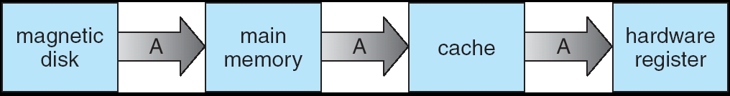
Migration of Integer A from Disk to Register
Multitasking environments must be careful to use most recent value, no matter where it is stored in the storage hierarchy
Multiprocessor environment must provide cache coherency in hardware such that all CPUs have the most recent value in their cache

Slide 44
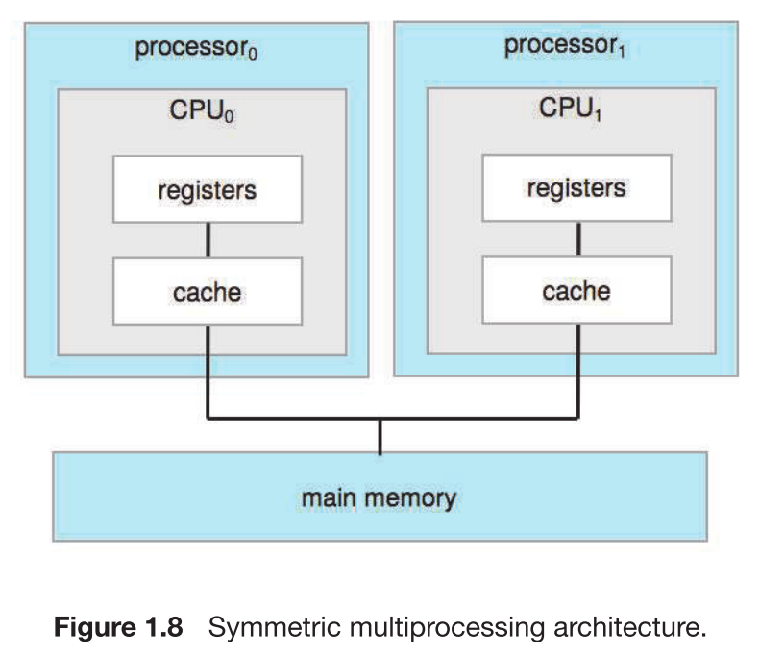
Multiprocessor Systems
SMP architecture
Each CPU processor has its own set of registers
All processors share physical memory over the system bus

Slide 45
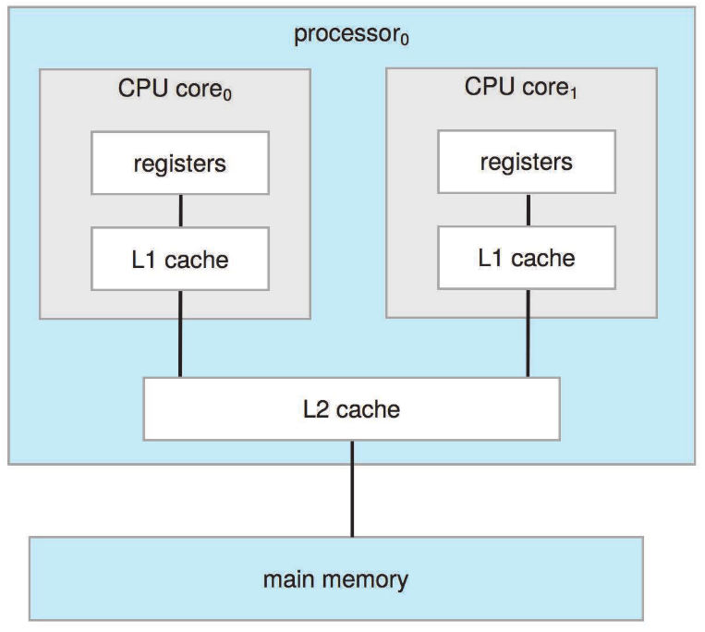
Multicore Systems
On-chip communication is faster than between-chip communication
Less power (good for mobile devices)

Slide 46
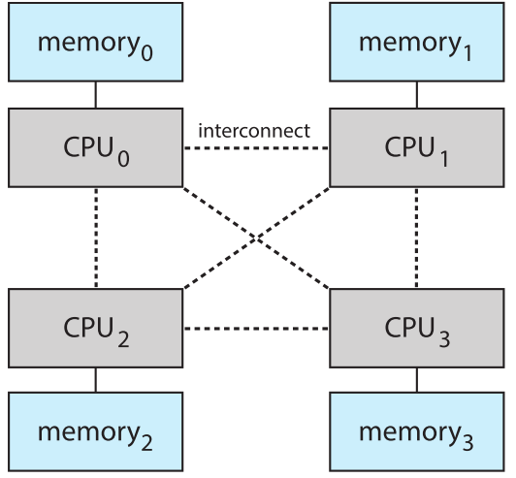
The NUMA Architecture
The CPUs are connected by a shared system interconnect
Scales more effectively as more processors are added
Remote memory across the interconnect is slow
Operating systems need careful CPU scheduling and memory management

Slide 47
Operating System Structure
Multiprogramming needed for efficiency (CPU utilization)
Single user cannot keep CPU and I/O devices busy at all times
Multiprogramming organizes jobs (code and data) so CPU always has one to execute
A subset of total jobs in system is kept in memory
One job selected and run via job scheduling
When it has to wait (for I/O for example), OS switches to another job
Timesharing (multitasking) is logical extension in which CPU switches jobs so frequently that users can interact with each job while it is running, creating interactive computing (interactivity)
Response time should be < 1 second
Each user has at least one program executing in memory process
If several jobs ready to run at the same time  CPU scheduling
If processes don’t fit in memory, swapping moves them in and out to run
Virtual memory allows execution of processes not completely in memory

Slide 48
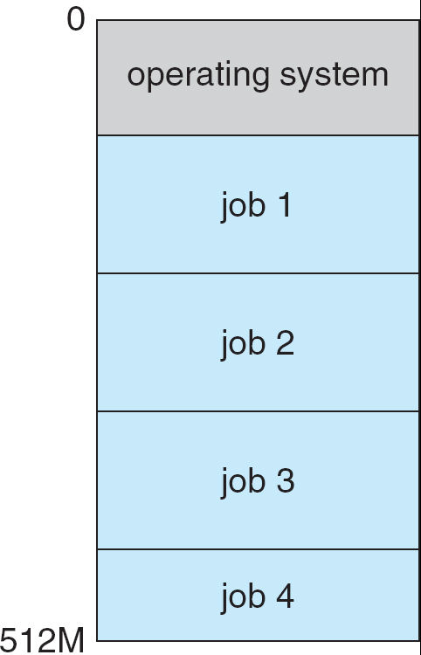
Memory Layout for Multiprogrammed System

Slide 49
Operating-System Operations
Interrupt driven by hardware
Software error or request creates exception or trap
Division by zero, request for operating system service
Other process problems include infinite loop, processes modifying each other or the operating system
Thus we need protection:
Dual-mode operation allows OS to protect itself and other system components
User mode and kernel mode(supervise mode), machine mode
Mode bit provided by hardware
Provides ability to distinguish when system is running user code or kernel code
Some instructions designated as privileged, only executable in kernel mode
System call changes mode to kernel, return from call resets it to user
Notes:
Trap: A software interrupt. The interrupt can be caused either by an error (e.g., division by zero or invalid memory access) or by a specific request from a user program that an operating-system service be performed.

Slide 50
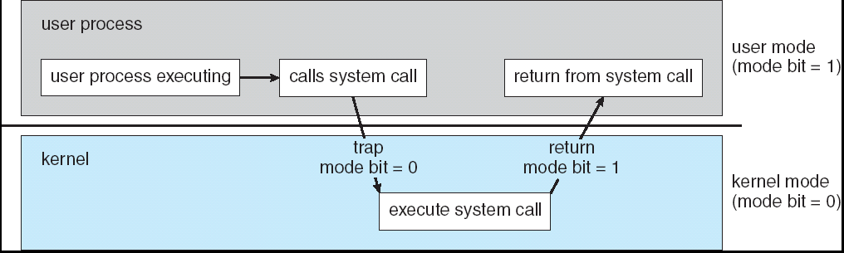
Transition from User to Kernel Mode
Timer to prevent infinite loop / process hogging resources
Set interrupt after specific period
Operating system decrements counter
When counter zero generate an interrupt
Set up before scheduling process to regain control or terminate program that exceeds allotted time

Slide 51
Process Management
A process is a program in execution. It is a unit of work within the system. Program is a passive entity, process is an active entity.
Process needs resources to accomplish its task
CPU, memory, I/O, files
Initialization data
Process termination requires reclaim of any reusable resources
Single-threaded process has one program counter specifying location of next instruction to execute
Process executes instructions sequentially, one at a time, until completion
Multi-threaded process has one program counter per thread
Typically system has many processes, some user, some operating system running concurrently on one or more CPUs
Concurrency by multiplexing the CPUs among the processes / threads

Slide 52
Process Management Activities
The operating system is responsible for the following activities in connection with process management:
Creating and deleting both user and system processes
Suspending and resuming processes
Providing mechanisms for process synchronization
Providing mechanisms for process communication
Providing mechanisms for deadlock handling

Slide 53
Memory Management
All data must be in memory before and after processing
All instructions must be in memory in order to execute
Memory management determines what is in memory when
Optimizing CPU utilization and computer response to users
Memory management activities
Keeping track of which parts of memory are currently being used and by whom
Deciding which processes (or parts thereof) and data to move into and out of memory
Allocating and deallocating memory space as needed

Slide 54
Storage Management
OS provides uniform, logical view of information storage
Abstracts physical properties to logical storage unit - file
Each medium is controlled by device (i.e., disk drive, tape drive)
Varying properties include access speed, capacity, data-transfer rate, access method (sequential or random)
File-System management
Files usually organized into directories
Access control on most systems to determine who can access what
OS activities include
Creating and deleting files and directories
Primitives to manipulate files and dirs
Mapping files onto secondary storage
Backup files onto stable (non-volatile) storage media

Slide 55
Mass-Storage Management
Usually disks used to store data that does not fit in main memory or data that must be kept for a “long” period of time.
Proper management is of central importance
Entire speed of computer operation hinges on disk subsystem and its algorithms
OS activities
Free-space management
Storage allocation
Disk scheduling
Some storage needs not be fast
Tertiary storage includes optical storage, magnetic tape
Still must be managed
Varies between WORM (write-once, read-many-times) and RW (read-write)

Slide 56
I/O Subsystem
One purpose of OS is to hide peculiarities of hardware devices from the user – ease of usage & programming
I/O subsystem responsible for
Memory management of I/O including buffering (storing data temporarily while it is being transferred), caching (storing parts of data in faster storage for performance), spooling (the overlapping of output of one job with input of other jobs)
General device-driver interface
Drivers for specific hardware devices

Slide 57
End of Chapter 1

Slide 58
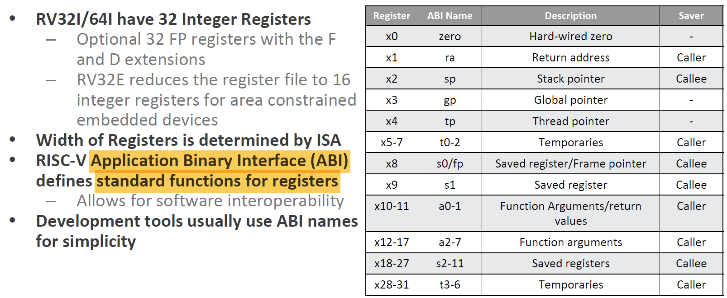
RISC-V Registers
Register file as follows:
In addition, RISC-V has a set of Control & Status Registers (CSRs)

